Slide 1


MACHINE LEARNING
MASTER CLASS
DAY – 4/30
Salary Estimation using K- Nearest Neighbor

Slide 2

01
Salary Estimation using K- Nearest Neighbor
Concept

Slide 3

02
Salary Estimation using K- Nearest Neighbor
Project

Slide 4
Eat that Frog
-Brian Tracy
🧠Book Suggestion💡

Slide 5
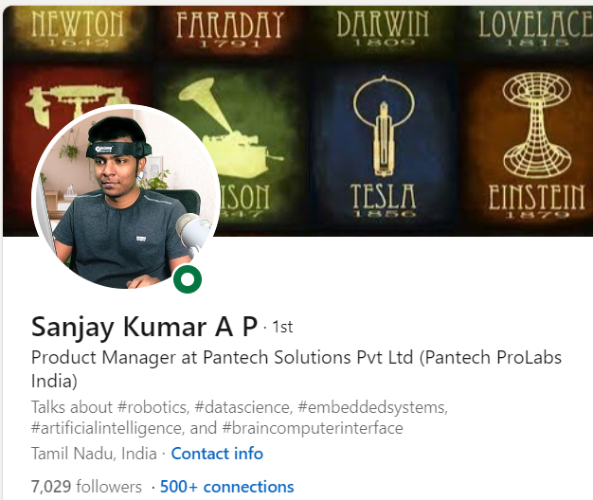
THANKS!
DO YOU HAVE ANY QUESTIONS?
Follow Me on the LinkedIn

